Slide 1

Emerging Technologies
Augmented/Virtual Reality
Artificial Intelligence
Internet of Things (IoT)
Robotics

Slide 2
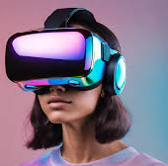
Augmented/Virtual Reality
AR/VR and sensor technologies can be used by businesses to aid in improving operational efficiency and productivity

Slide 3
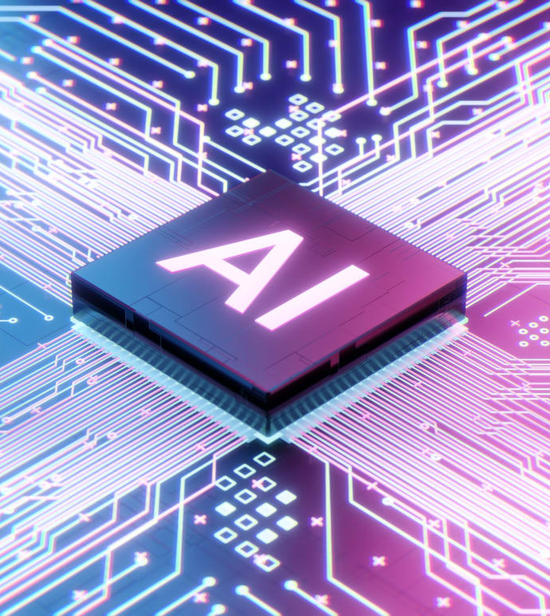
Artificial Intelligence
AI can help improve data security and decision-making speed/accuracy
This could be used in secondary sectors for improving production efficiency and quality control
AI can also be used in tertiary sectors for improving customer experience in customer support

Slide 4

Internet of Things (IoT)
IoT can provide businesses with the data needed to improve marketing their products/services to potential customers
Decrease costs – IoT devices are low cost to produce
Increase sales – Due to low production costs, they have low price tags so people can buy many

Slide 5
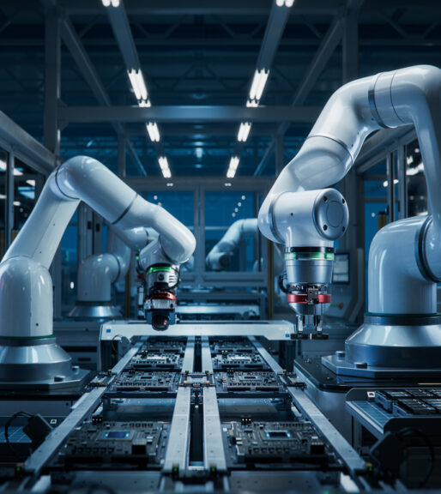
Robotics
Robotics can be used to automate repetitive tasks that humans don’t want to do
Makes the business faster
Increased efficiency
Lower production costs

